Slide 1

A brief analysis of berlin, Germany
IBM data science capstone project
By: Ijlal Muneeb

Slide 2
Geography of berlin
Total of 12 Boroughs, called Bezirke
Divided into 85 Neighbourhoods called Ortteile
Neighbourhoods had their own authorities in the olden days
Now moved to a more centralized structure

Slide 3
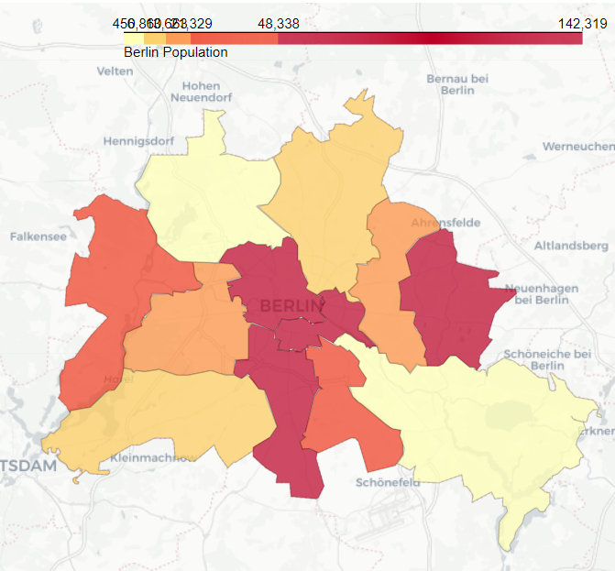
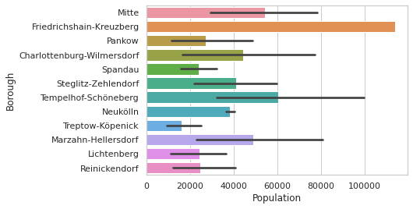
Population
The population of Berlin is shown in the figure, where larger the population equals darker colors and lower populations are represented by lighter colors respectively
These numbers are taken from the wikitable based on the 2008 census

Slide 4
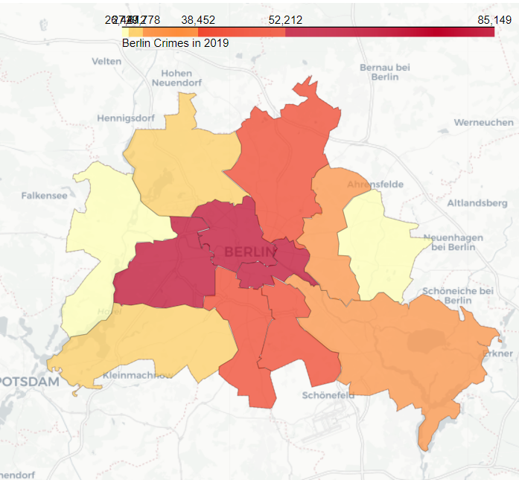
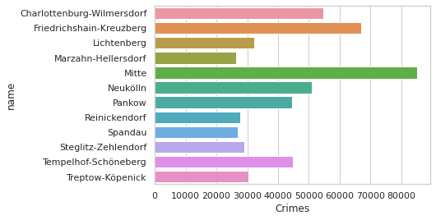
crime
Crime in Berlin follows a linear relationship with population, densely populated areas have relatively higher crime than less dense areas

Slide 5
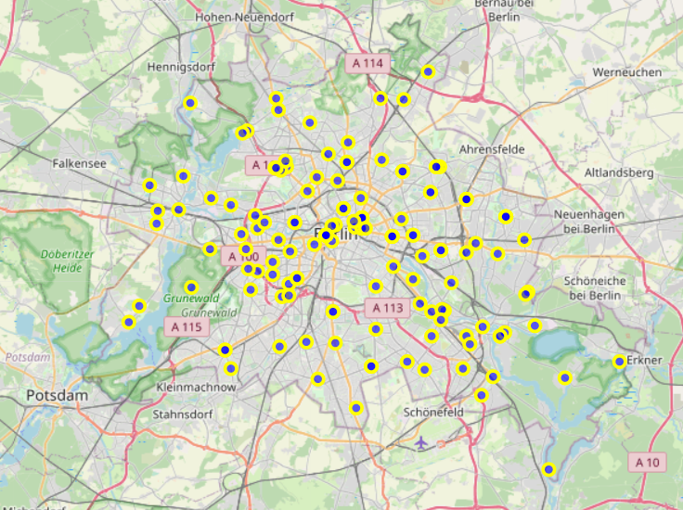
Crime
This figure shows the locations of all the crimes that took place in Berlin in the year 2019

Slide 6
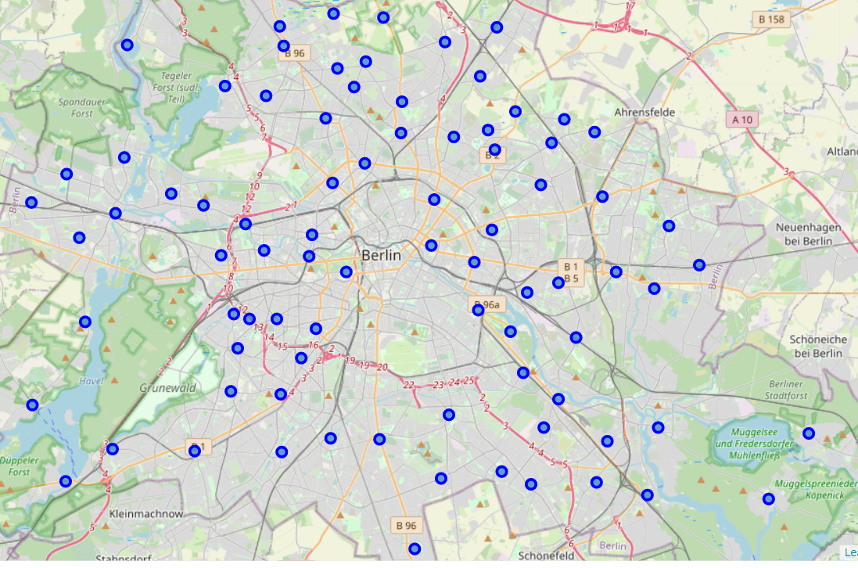
Neighbourhoods
This figure shows the locations of neighbourhoods in Berlin
It allows us to visually pick and choose locations based on the results seen before

Slide 7
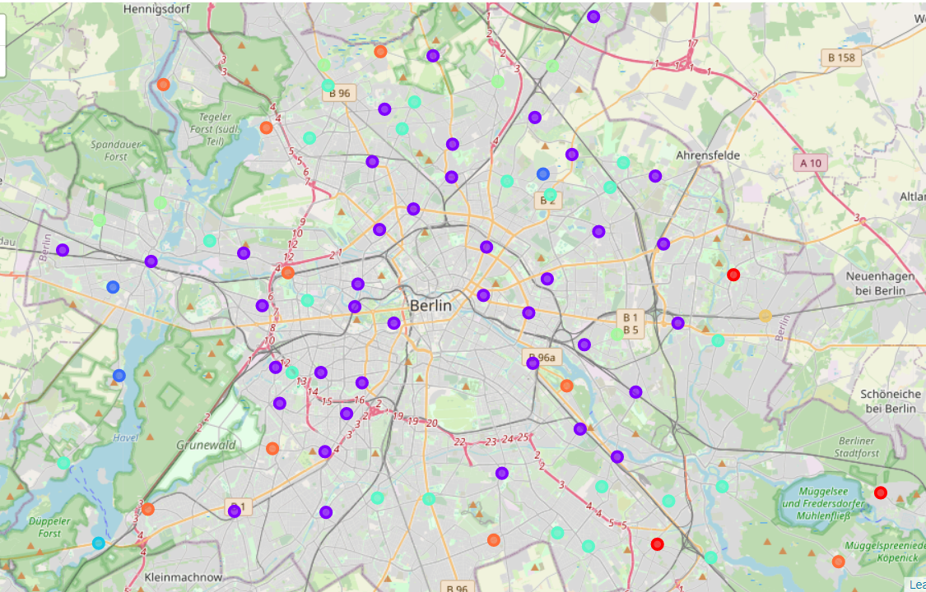
Machine Learning
Clustering using K-Means
The neighborhoods are compiled into groups based on the similarity of their surroundings, in terms of social amenities and other facilities
Color coding shows similarity among clusters

Slide 8
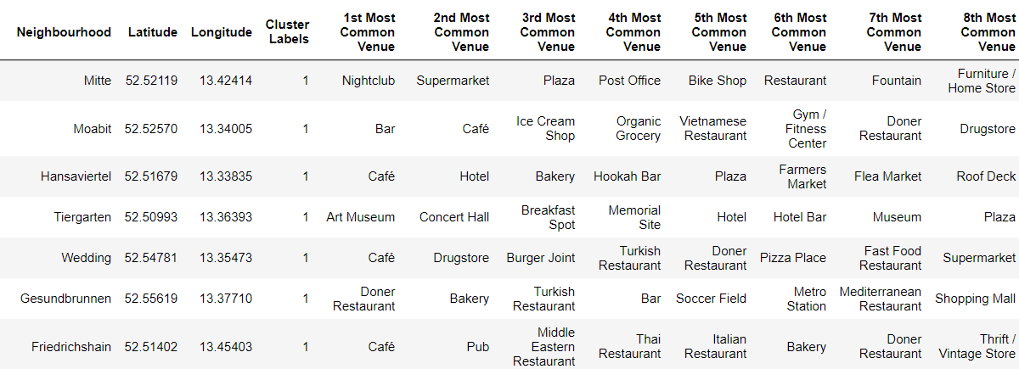
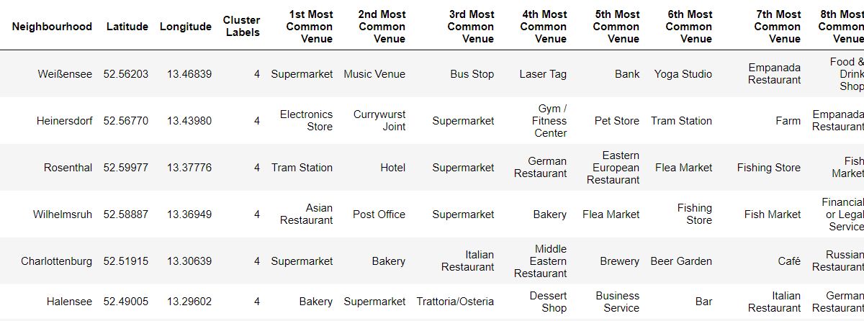
Cluster examination
Each cluster comprises of neighbourhoods along with their top ten most common venues
This provides insight into what kind of businesses are being run in a particular area of interest

Slide 9
conclusion
A detailed analysis of Berlin shows us that the social landscape of Berlin is quite evenly distributed
No crime hotspots exists and a linear crime-population relationship suggests that crime is under control
Most neighbourhoods provide very similar surroundings and venues
Certain neighborhoods lack a particular type of social amenities and might interest investors to look into such opportunities

